Slide 1
OSCE Questions
7/3/2018
PWH

Slide 2
Question 1
66/M, construction site worker.
Left leg hit by a fallen metal pipe.
c/o severe pain and swelling down from left knee

Slide 5
Question 1
1. Describe the clinical photo.
2. Interpret the Xray findings.
3. What is the most likely diagnosis
4. How to diagnose the above condition?
5. What test can help diagnosing the condition? How to interpret the findings?
6. What are the treatment options?
Notes:
Pain: -out of proportion to the injury -not relieved by analgesia -increased with passive stretch of compartment muscles (most specific)
Pallor
Paraesthesia
Polar: -cold limb (late finding)
Paralysis (late finding)
Pulselessness (late finding)

Slide 6
Question 2
40/M, hiker.
Fever x 7/7, headache, malaise
Temp 38.5deg. BP/P stable

Slide 7
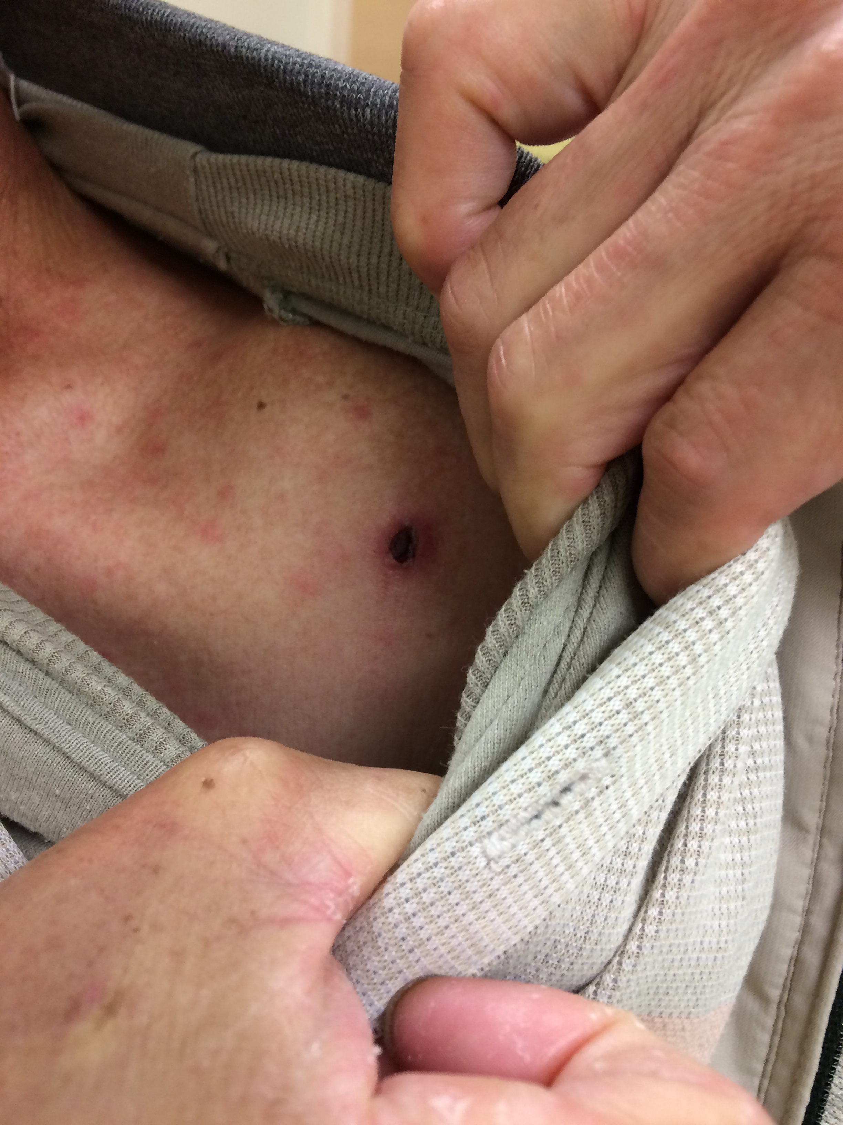
Left shoulder

Slide 8
Question 2
Describe the clinical photos.
What is the most likely diagnosis?
What is the pathogen?
What is the vector?
How to confirm the diagnosis?
Is it a notifiable disease?
What is the treatment?
What can be the complications of this condition?

Slide 9
Question 3
34/M, chronic smoker, familial hyperlipidemia defaulted FU
Sudden onset chest pain one hour ago
BP 121/65, P 76/min, SpO2 100% RA

Slide 11
Question 3
Describe the ECG
What would you do?
What is the significance of this ECG abnormality?
What are the risk factors for this ECG abnormality to occur?

Slide 12
Question 4
68/F, good past health
Coughing with whitish sputum x 1/52
c/o brusing on abdomen x 2/7
Stable vitals

Slide 14
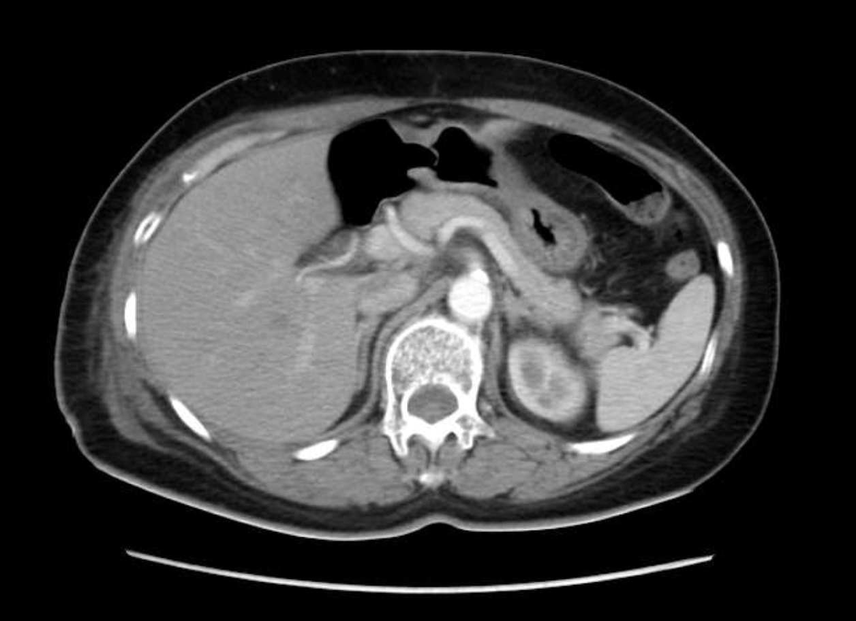

Slide 16
Question 4
Describe the clinical photos. What are the names of the signs?
In general, what are the possible causes?
Describe the CT scan findings.
If the patient is on dabigatran. What drug can be given?
If patient become unstable despite medical treatment, what can be done?

Slide 17
Question 5
39/M, known eczema on TCM
Progressive rash from face to whole body for 1 week
Temp 37.6 BP 126/93, Pulse 87

Slide 18
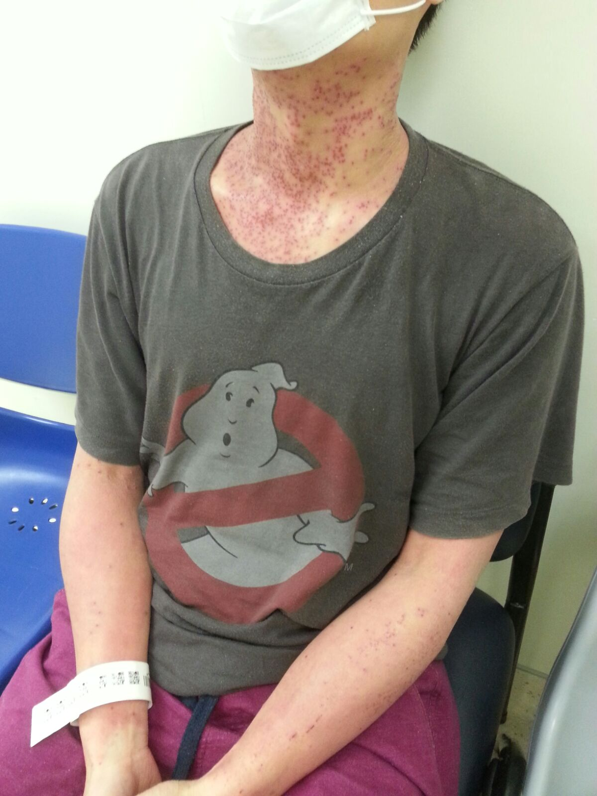

Slide 19
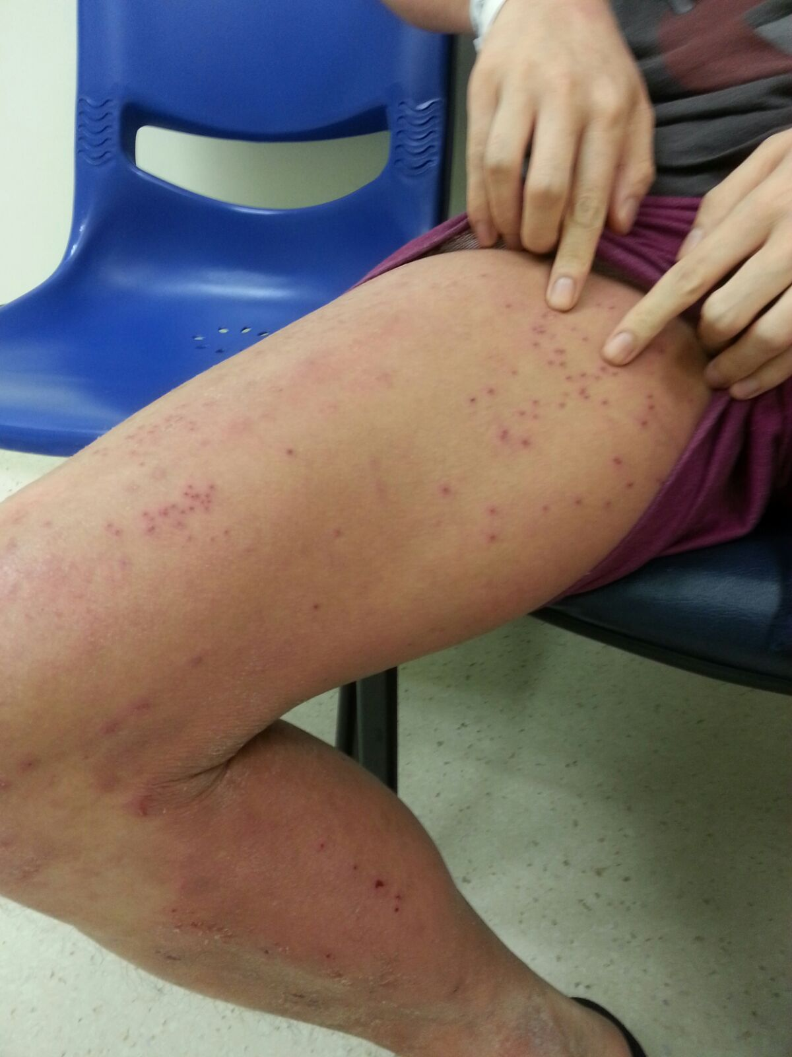

Slide 20
Question 5
Describe the clinical photos.
What is the diagnosis ?
What is the usual causative agent?
How to confirm this condition?
Who are at risk of this condition?
What would you do?

Slide 21
Question 6
48/M, Known DM
Frontal headache and runny nose x 3/7
Found forehead swelling and tenderness on P/E
Vital stable, afebrile

Slide 22
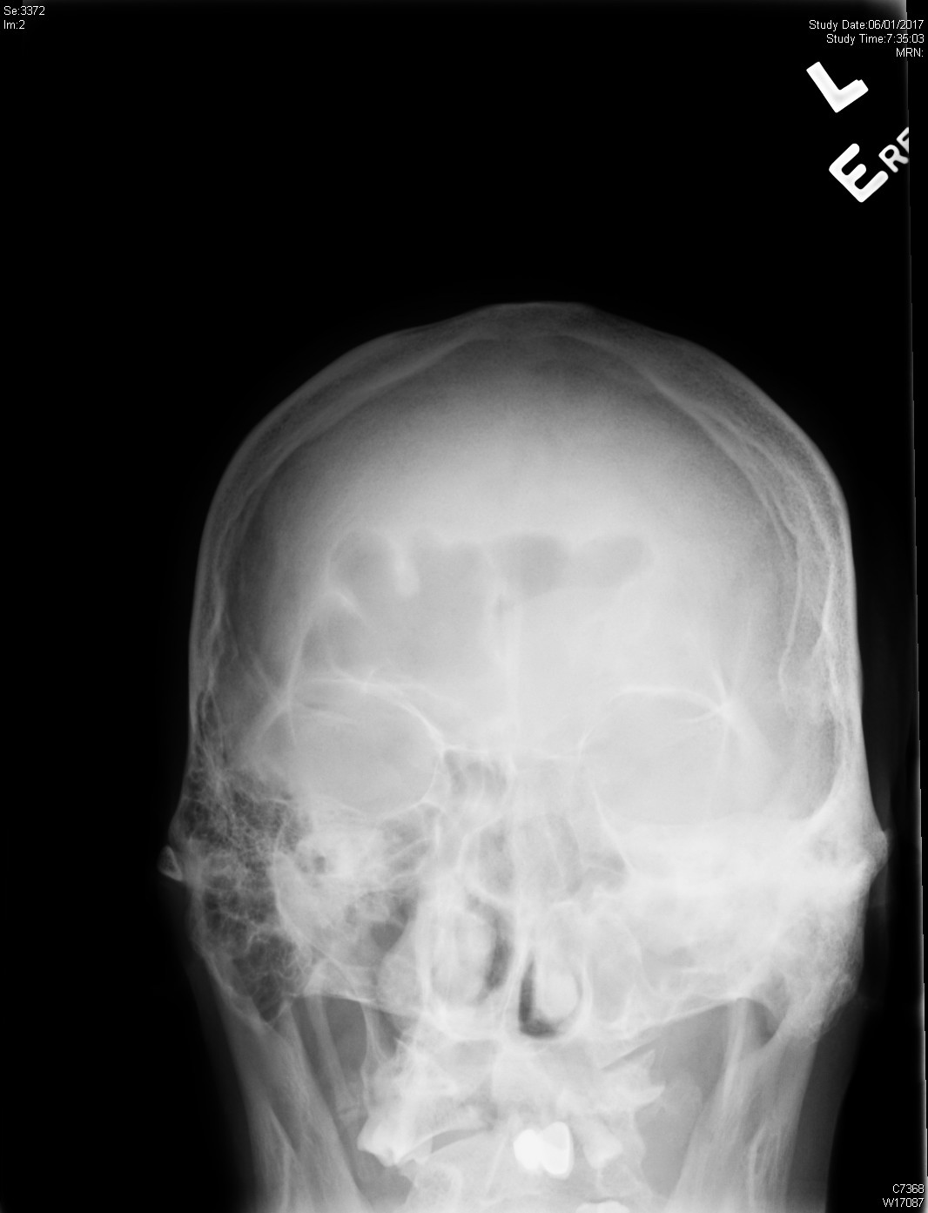
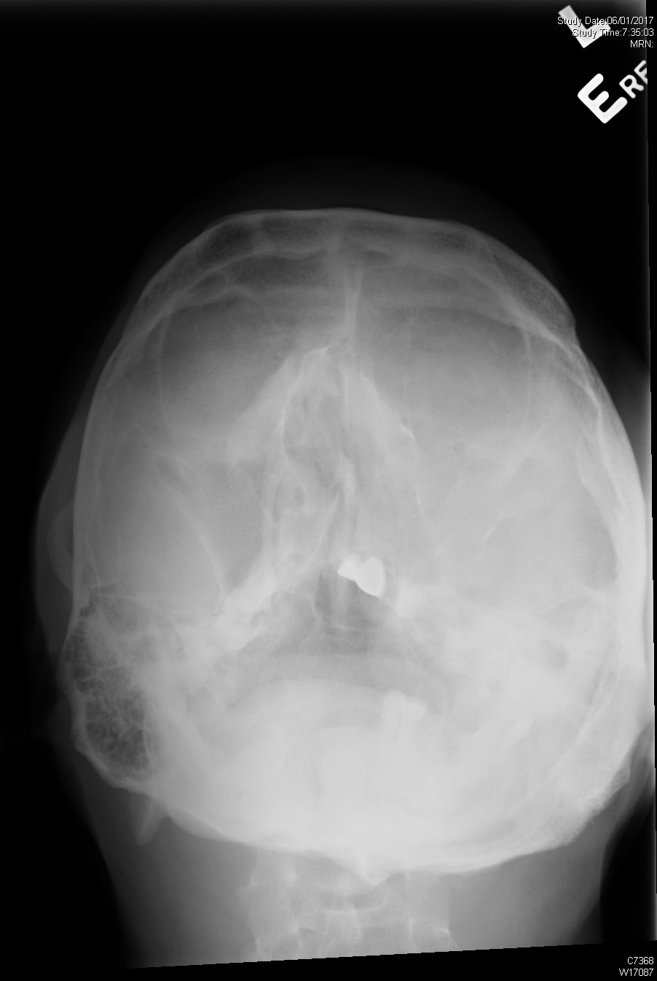

Slide 23
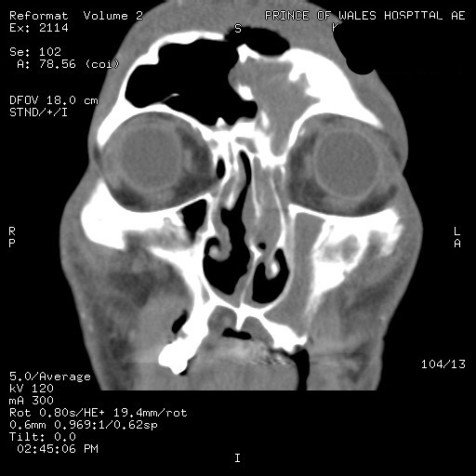

Slide 24
Question 6
Describe the Xray.
Describe the CT scan.
What is the diagnosis?
What would you do?
What are the possible complications?

